Slide 1
AI MAVERICKS - EMAIL INTEL "Turning issues into insights!”

Slide 2
Team Introduction -HARSHITHA MARUPAKA -SPALLYA OMAR -SRINIVAS DINGARI -RANA ANVESH REDDY YERAMAREDDY -SHIVAKISHORE CHERUPALLY

Slide 3
Problem Statement / Current State
Business Context
Application teams, especially 3L teams (production support and non prod support), receive numerous complaints and technical issues through shared MS Outlook inboxes daily.
Problem Statement
Develop a Gen Al-powered Email Classification and OCR solution that can:
1. Accurately extract, interpret the context and categorizes emails in to predefined request types and sub request types based on the sender's intent along with reasoning.
2. Context based data extraction: Extract configurable fields like deal name, amount, expiration date etc. from both email bodies and attachments varying based on the request type.
3. Handling multi request email with primary intent detection: The solution should be able to support complex cases where single email can contain multiple request types ensuring each is identified based on sender's ask. Also determine the primary request which represent sender's main intent even when the email discuss multiple topics.

Slide 4
Purpose/ Opportunity Statement
Introducing Email Intel
- An AI-powered tool that monitors shared inbox for applications' functional and technical issues from within past emails.
- Automatically reads and analyzes emails to identify the problem/issue being reported. - Cross-references a dynamic knowledge graph to find existing solutions.
- Provides automated resolution steps if available or alerts specific team members for manual intervention. - Continuously updates the knowledge graph with new solutions for future reference.

Slide 5
Solution / Desired State
Email Intel is an innovative tool designed to streamline the management of functional and technical issues within an application team. By monitoring a shared inbox for incoming queries.
Email Intel leverages advanced Natural Language Processing (NLP) to identify and categorize issues. It then references a comprehensive Knowledge Graph Database to find solutions based on historical data. If a solution to the reported issue is not readily available, the tool alerts specific team members to provide a resolution.
Over time, the Continuous Learning Module ensures that the system evolves by learning from new issues and resolutions, enhancing the Knowledge Graph Database. This integrated approach not only improves response times but also ensures that the application team continuously optimizes its problem-solving capabilities.
Key Features: -
-Email Monitoring: Real-time scanning of shared inboxes
. -AI Analysis: Natural Language Processing (NLP) to understand and categorize issues.
- Knowledge Graph Integration: A growing database of solutions for quick reference.
- Automated Responses: Immediate resolution steps for known issues.
- Alert System: Notification to team members for unresolved or critical issues.
- Continuous Learning: Updates the knowledge graph with new solutions and feedback.

Slide 6
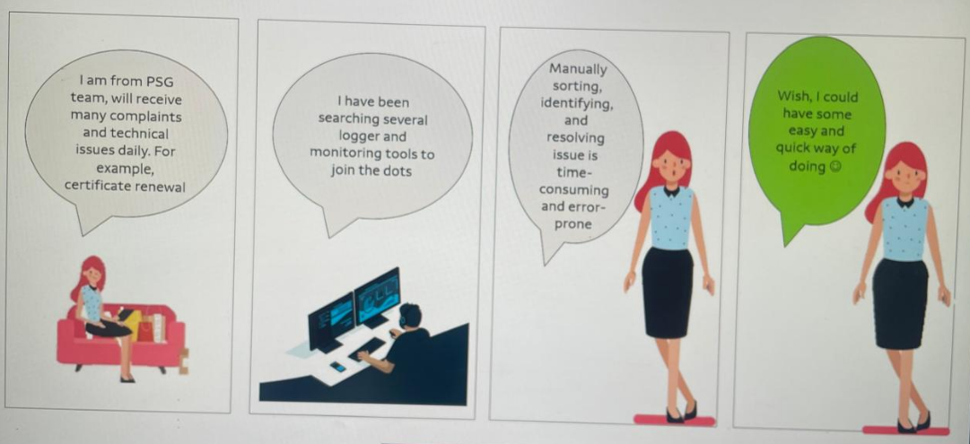
Use Case: Let’s meet Maina

Slide 7
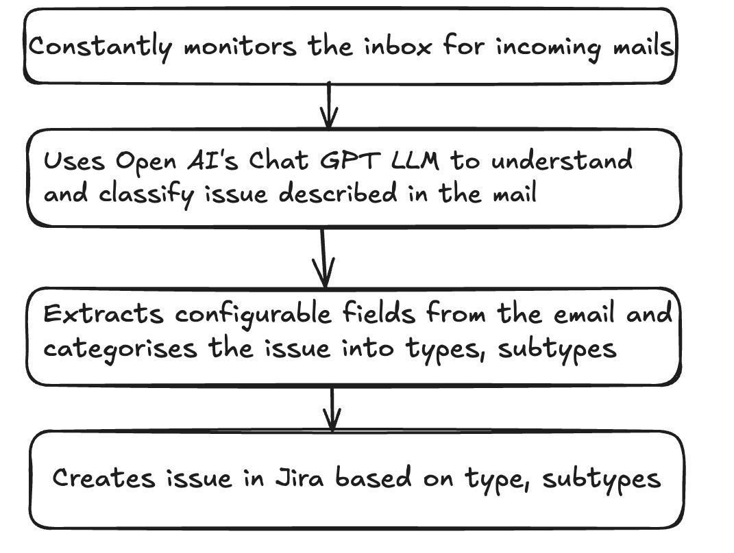
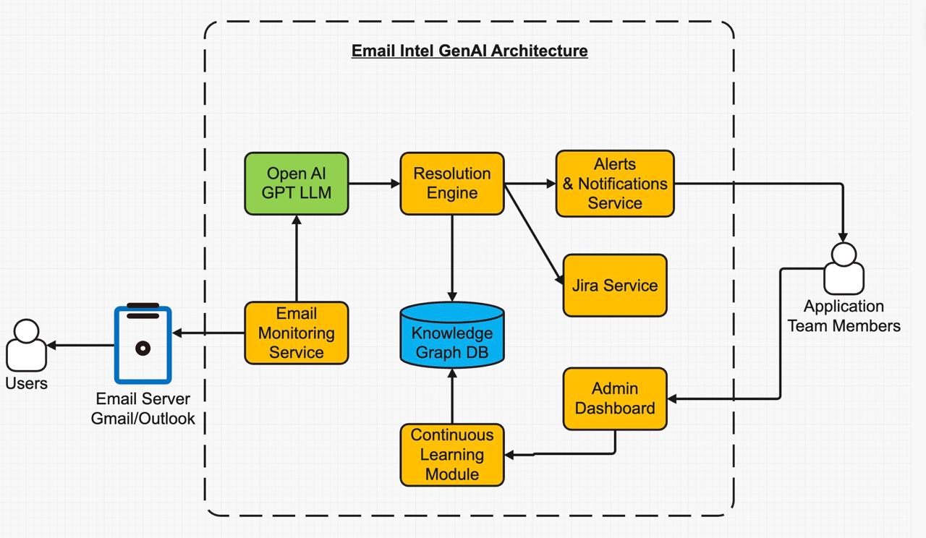
Technical Architecture / Workflows

Slide 8
Appendix

Slide 9
Thank you

